Slide 1
Horizon 2020: Polimi's Results (2014 – 2020)

Slide 2
HORIZON 2020
In the H2020 programme Politecnico is
With
And
19th in Europe
12th among EU universities
1st among Italian universities
430 Funded projects
12.00% EU's Success rate
15.42% Polimi's Success rate
13,51% Pillar 1 16,54% Pillar 2
16,98% Pillar 3 57,89% Euratom
16,13% SWFS 14,71% SEWP
117 Coordinator
300 Partner
13 Third party
187.8 M€ granted
MSCA (Marie Skłodowska-Curie Actions)
85 funded projects
24 Individual Fellowships
44 Innovative Training Networks
15 Research and Innovation Staff Exchange
2 NIGHT (notte dei Ricercatori)
35 Coordinator
50 Partner

Slide 3
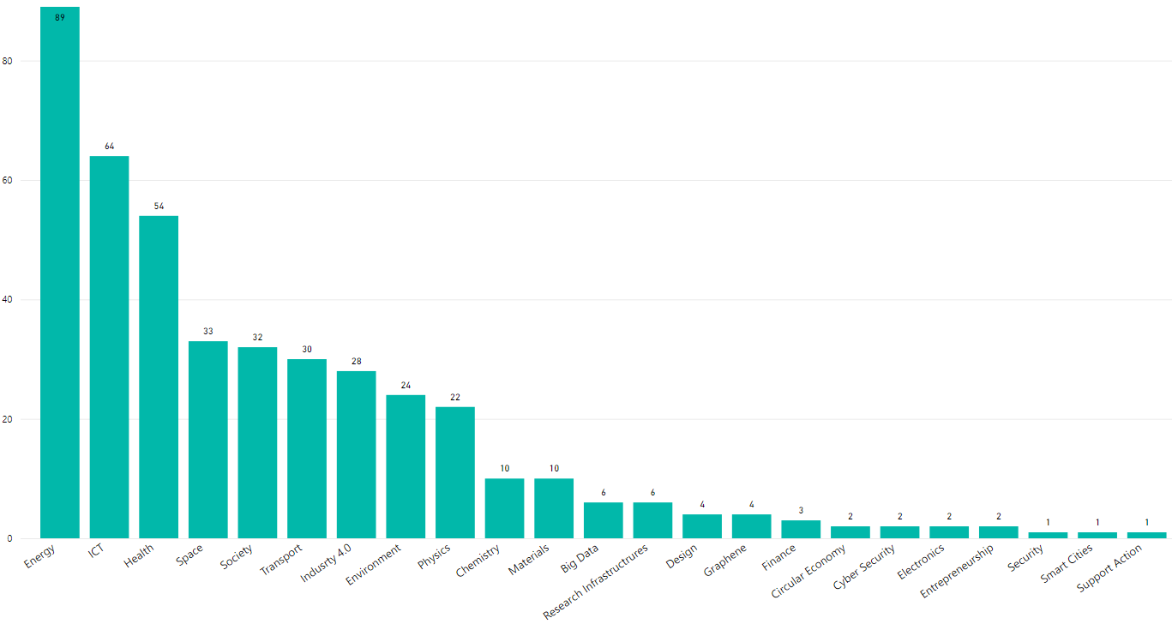
HORIZON 2020: PROJECTS
Main research field
Status
203 Closed
222 Active
5 Starting

Slide 4
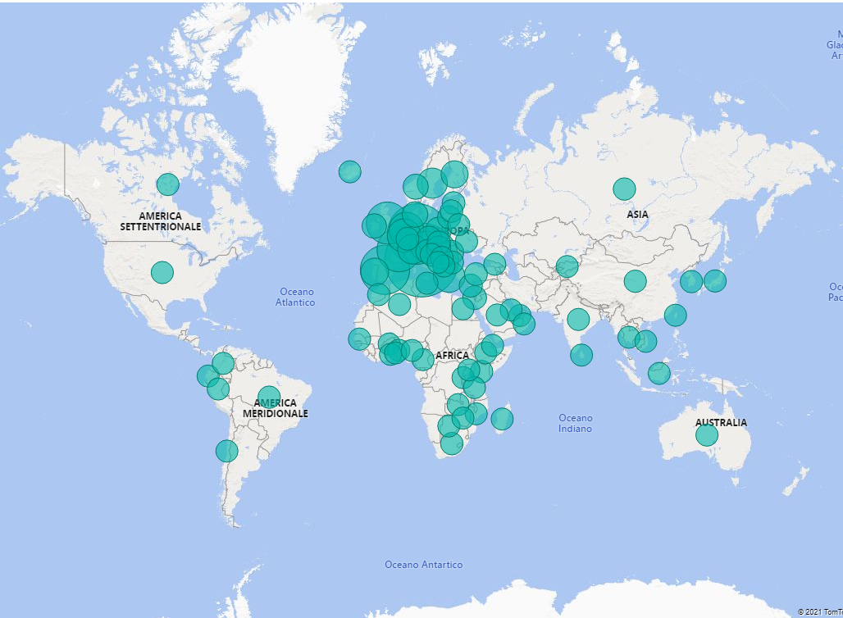
HORIZON 2020: PARTNERS
3244 Polimi's international collaborations (number of distinct partners)
TOP 10 collaborating institutions
Partners | Country | Projects with Polimi
COMMISSARIAT A L ENERGIE ATOMIQUE ET AUX ENERGIES ALTERNATIVES | FR | 43
FRAUNHOFER GESELLSCHAFT ZUR FORDERUNG DER ANGEWANDTEN FORSCHUNG EV | DE | 36
TECHNISCHE UNIVERSITEIT DELFT | NL | 32
CENTRE NATIONAL DE LA RECHERCHE SCIENTIFIQUE CNRS | FR | 30
CONSIGLIO NAZIONALE DELLE RICERCHE | IT | 30
FUNDACION TECNALIA RESEARCH & INNOVATION | ES | 30
KARLSRUHER INSTITUT FUER TECHNOLOGIE | DE | 26
TECHNISCHE UNIVERSITAET DRESDEN | DE | 25
DANMARKS TEKNISKE UNIVERSITET | DK | 23
AGENCIA ESTATAL CONSEJO SUPERIOR DE INVESTIGACIONES CIENTIFICAS | ES | 22

Slide 5
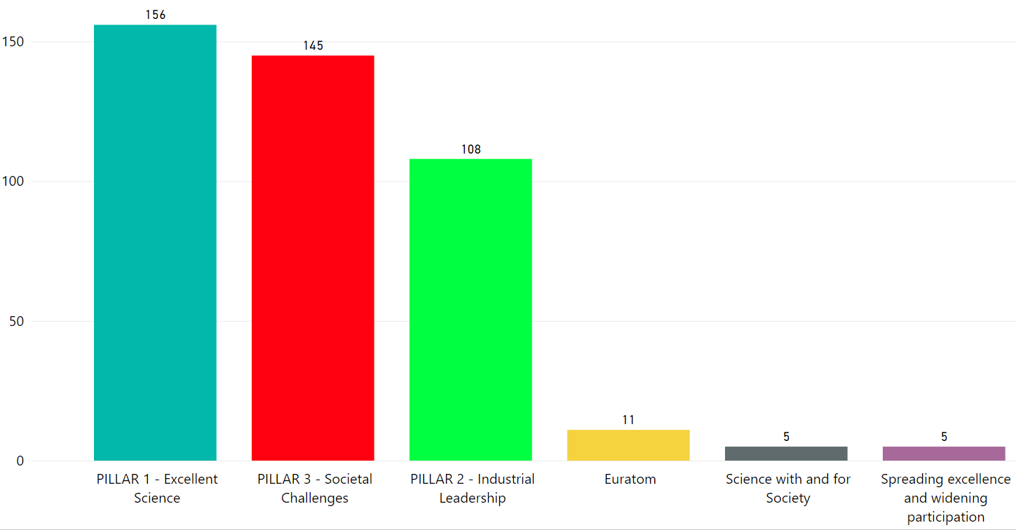
H2020 RESULTS
Pillars

Slide 6
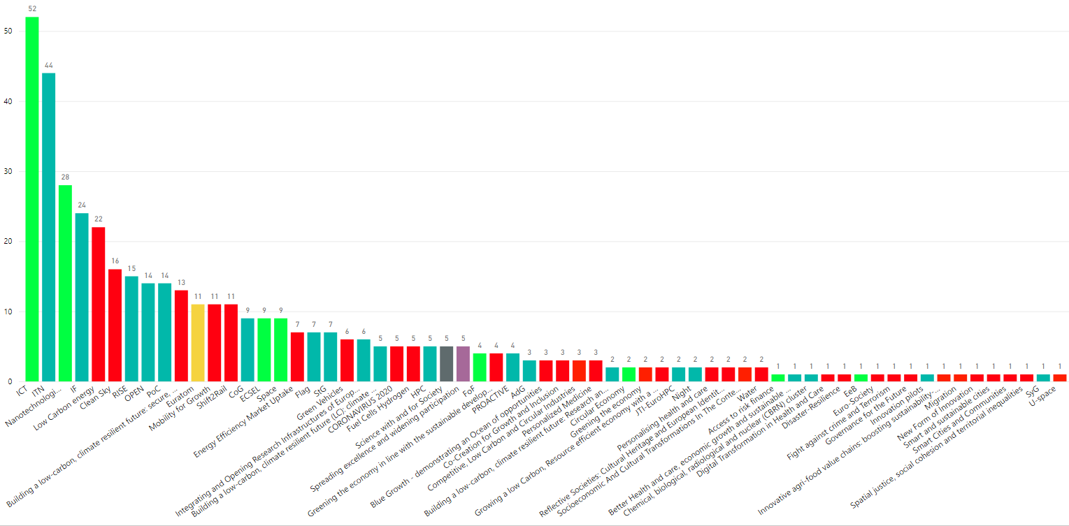
H2020 RESULTS
Calls

Slide 7
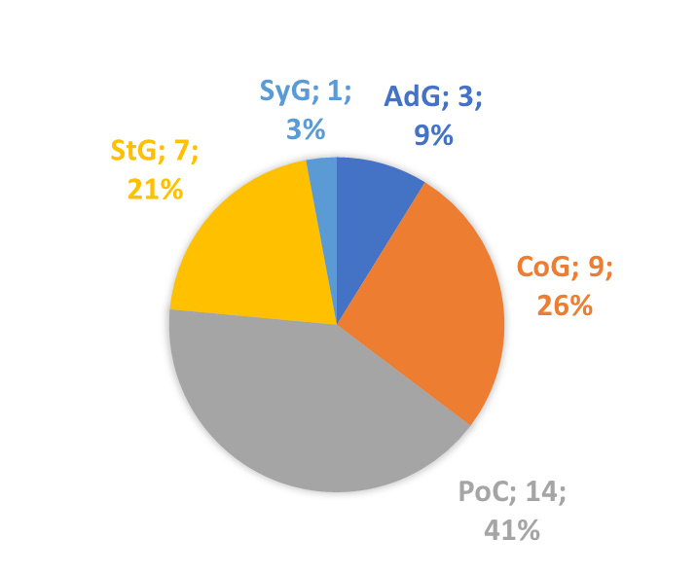
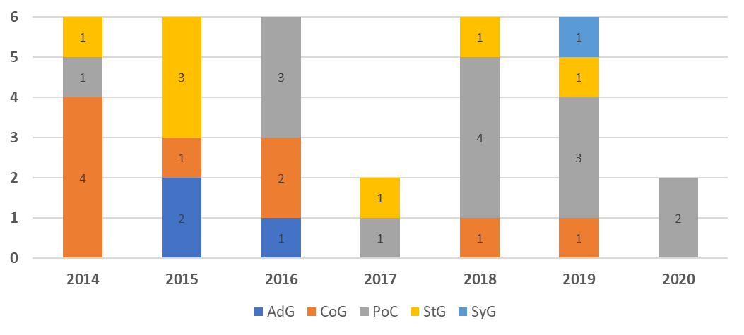
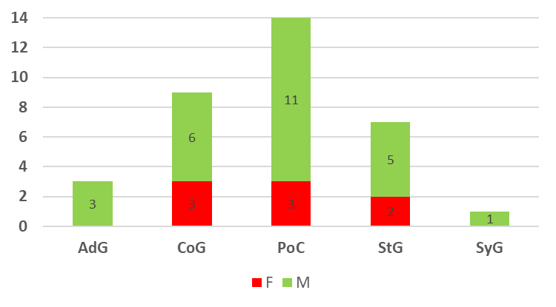
H2020 ERC
ERC by call
34 ERCs
38.985.776,59 € Granted amount
13,23% Success rate
ERC by year
ERC by gender

Slide 8
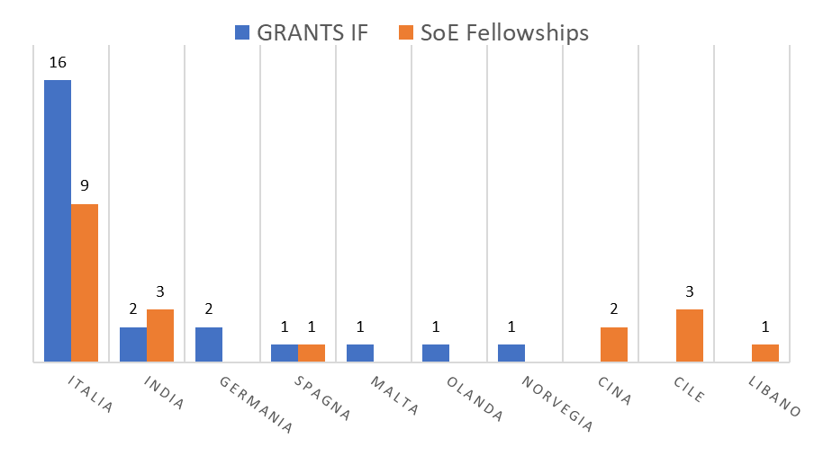
H2020 MSCA IF Masterclass e POLIMI Seal of Excellence fellowships
N. BANDO | ANNO | PROPOSTE MSCA IF PRESENTATE | GRANTS MSCA IF VINTI | SELEZIONATI SOE | POLIMI SOE FELLOWSHIPS
I° BANDO | 2018 | 33 | 6 | 9 | 5
II° BANDO | 2019 | 35 | 4 | 6 | 4
III° BANDO | 2020 | 49 | 6 | 17 | 10
IV° BANDO | 2021 | 35
Nazionalità MSCA IF e SOE
GENDER MSCA IF e SOE
 | GRANTS MSCA IF | POLIMI SOE FELLOWSHIPS
F | 6 | 9
M | 18 | 10

